Slide 1
Opportunity for Criminals?
COVID-19 Pandemic
Yinhe Lu and Yuki Nishimura, MS in Data Science
CUEPID Data Challenge, April 20th, 2020

Slide 2

Introduction
Criminals have been taking advantage of vulnerabilities due to COVID-19.
How are COVID-19 and crimes related?
We focus on burglary and robbery, and we aim to discover a relationship between these crimes and COVID-19 to understand how criminals are taking advantage of COVID-19.
This knowledge can support people and businesses understand which crimes they should look out for more, which may help prevent additional crimes.
Scammers knocking on doors and pretending to be CDC workers
(Source: Twitter)
Data sources:
NYCHealth (COVID-19 Cases in NYC from March 2nd to April 12th 2020)
SpotCrime (Burglary and Robbery cases in NYC from March 2nd to April 12th for years 2018 to 2020)
Workflow and Tools:
1. Collect Data, 2. Preprocess Data, 3. Conduct Analysis using the following tools:
Jupyter Notebook (Tool to run scripts to generate visualizations)
CartoDB (Data visualization tool to generating heatmaps)

Slide 3
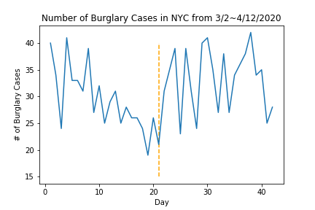
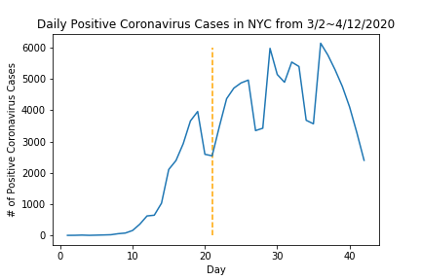
Coronavirus vs Burglary
=> entry into a building illegally with intent to commit a crime, especially theft
( by Oxford dictionary)
Main Finding:
There is an obvious difference in the # of burglary cases before and after the shelter-in-place order.
Correlation
vs COVID-19 Cases before order | vs COVID-19 Cases after order | vs COVID-19 Cases throughout
-0.62 | 0.58 | 0.20
Shelter-in-place order
(First two correlations are statistically significant at significance level 0.01)
Hypothesis
Since the # of burglary cases decrease as COVID-19 cases increase before shelter-in-place order:
=> instability in people’s lifestyles
=> uncertainty in location of people
Since the # of burglary cases increase as COVID-19 cases increase after shelter-in-place order:
=> certainty in location of people (at home)
=> businesses become easier targets

Slide 4
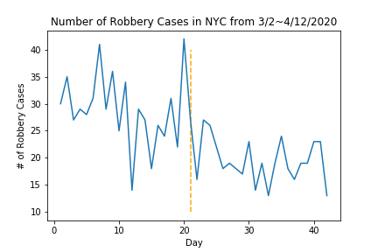
Coronavirus vs Robbery
=> the action of taking property unlawfully from a person or place by force or threat of force
( by Oxford dictionary)
Main Finding:
The # of robbery cases are low when the # of positive coronavirus cases are high.
(Regardless of the shelter-in-place order)
Correlation
vs COVID-19 Cases before order | vs COVID-19 Cases after order | vs COVID-19 Cases throughout
-0.33 | -0.13 | -0.62
(Last correlation is statistically significant at significance level 0.01)
Hypothesis
Criminals may be changing their strategies from taking property from people by force, to just taking property (=> burglary), since it is “easier”.
Criminals may not want human contact due to the COVID-19.

Slide 5
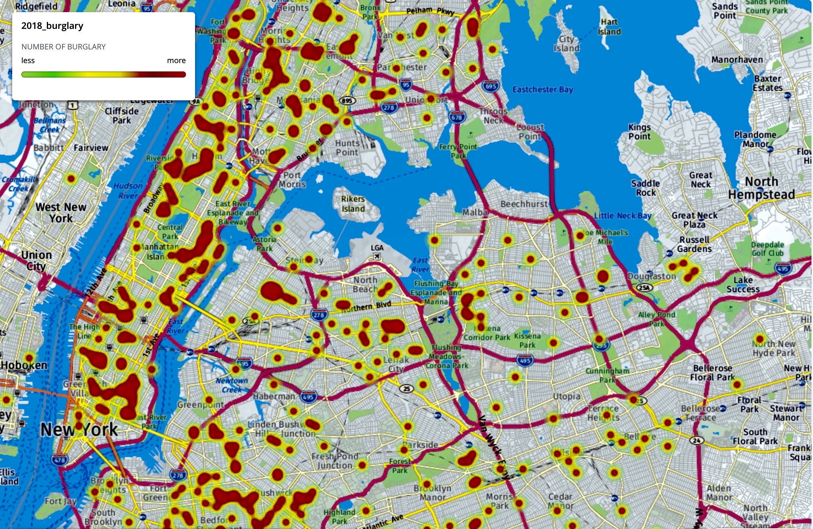
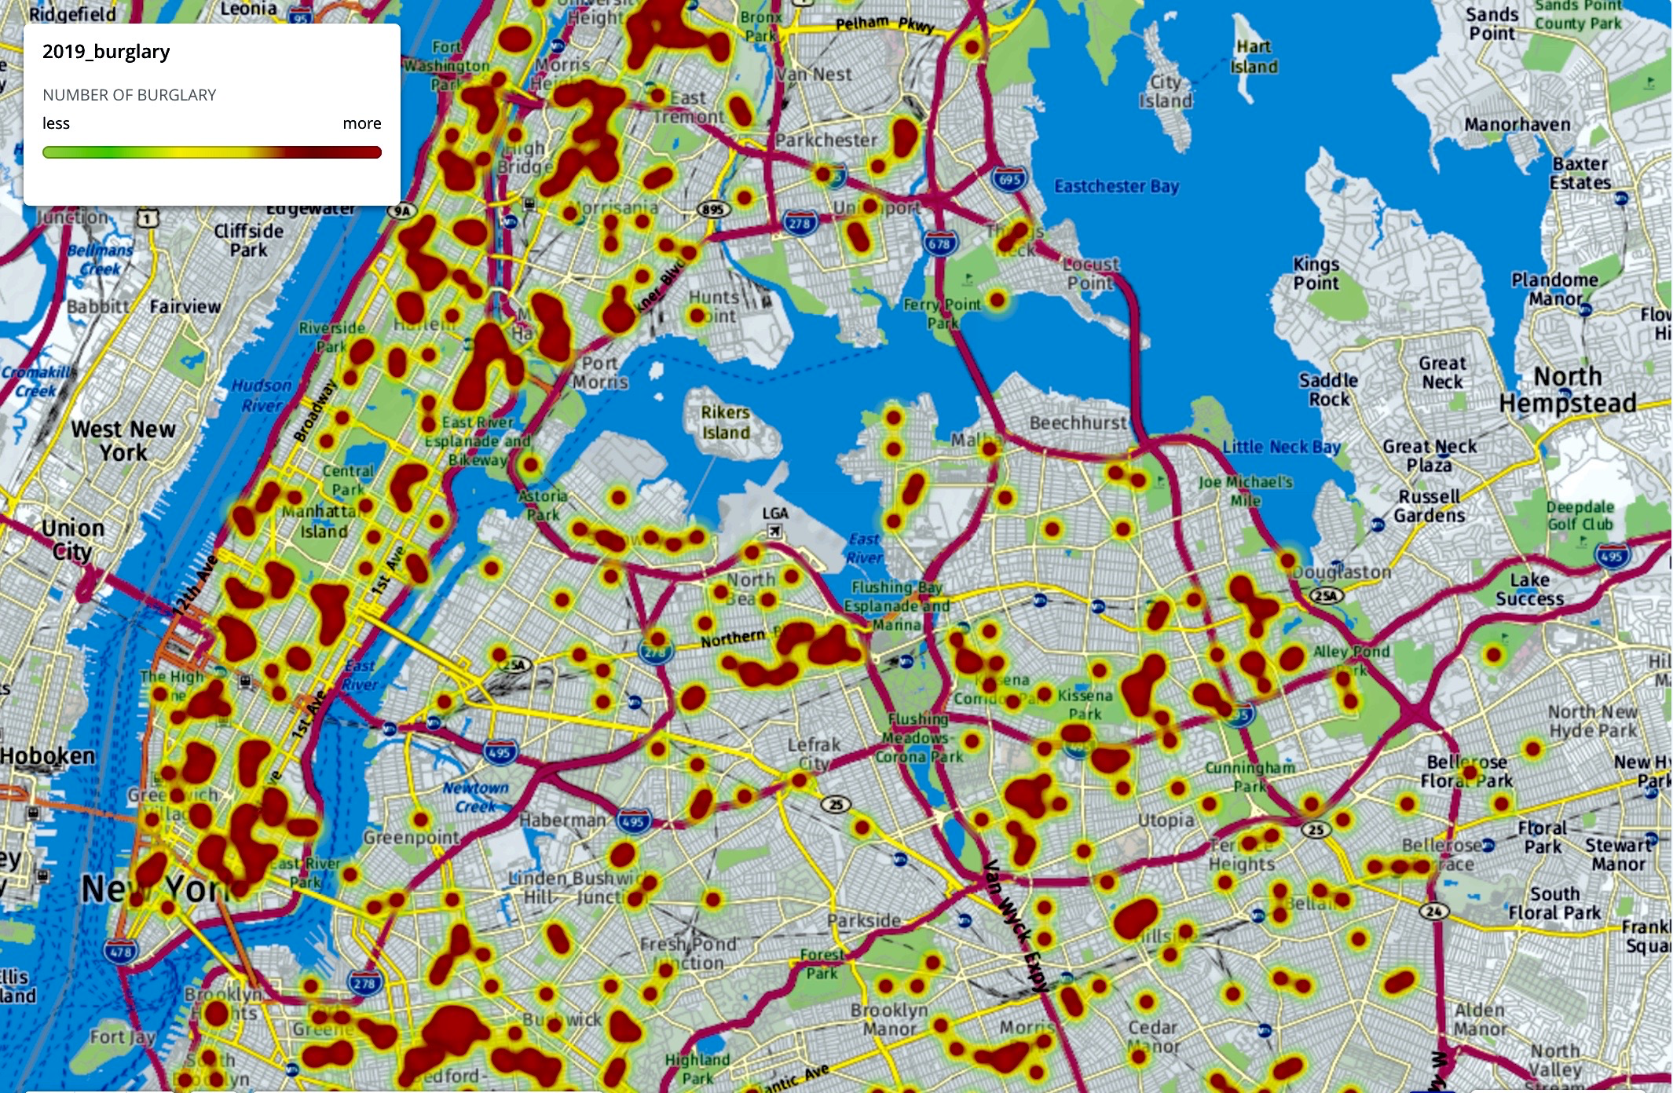
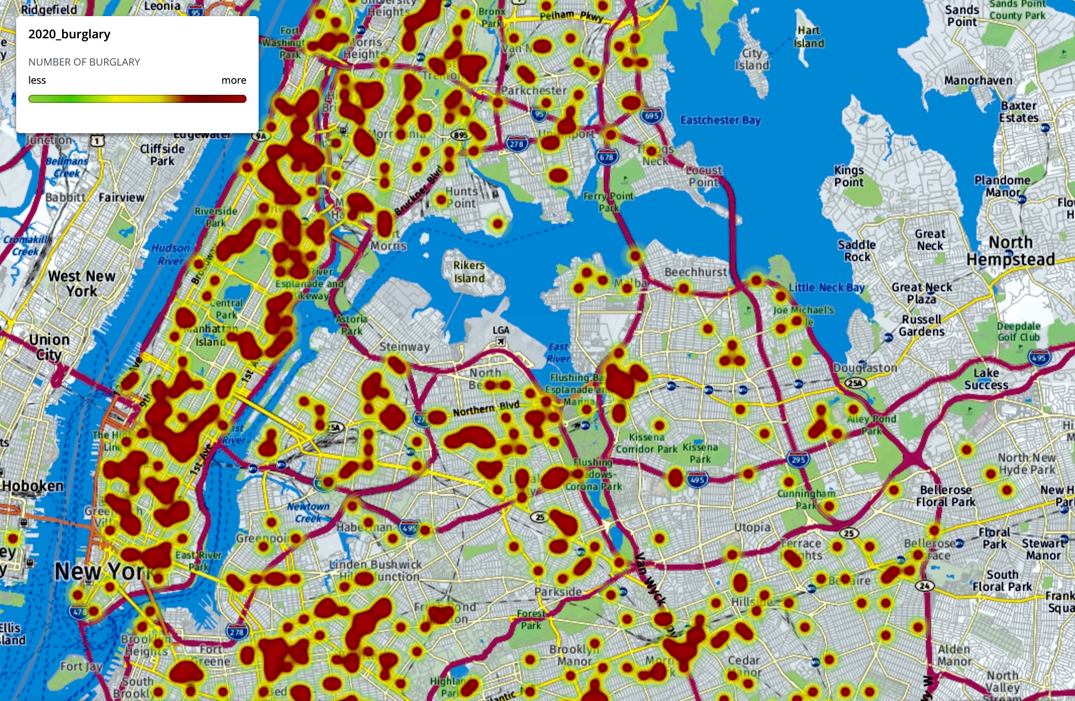
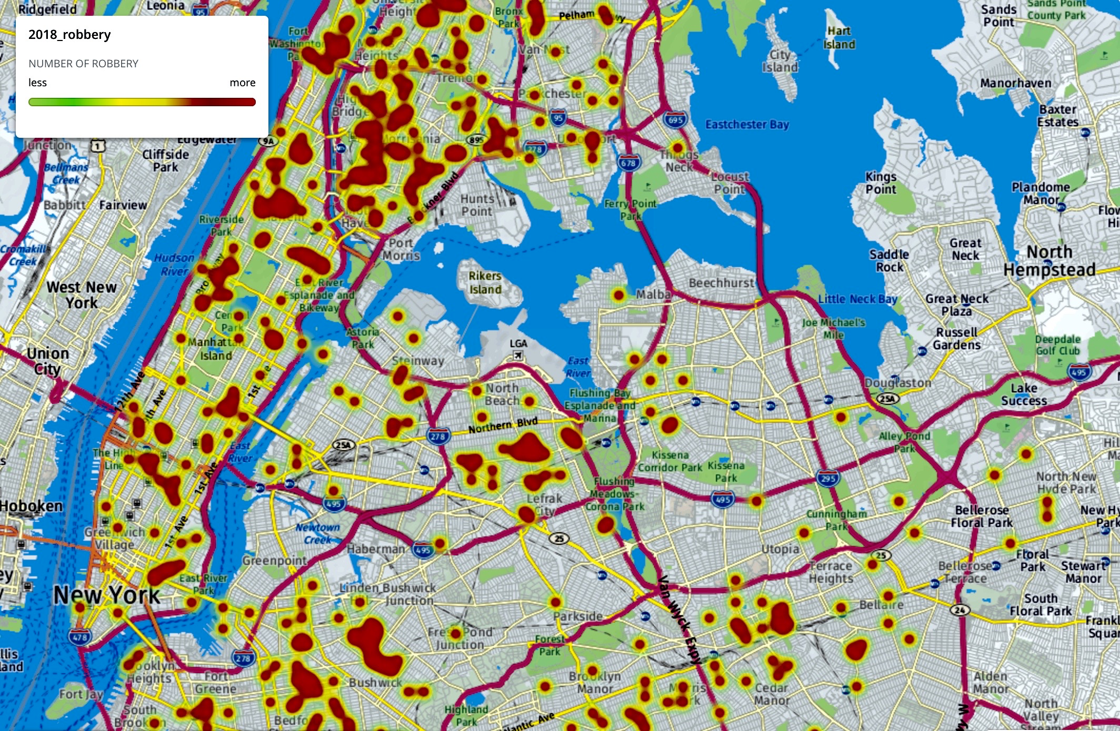
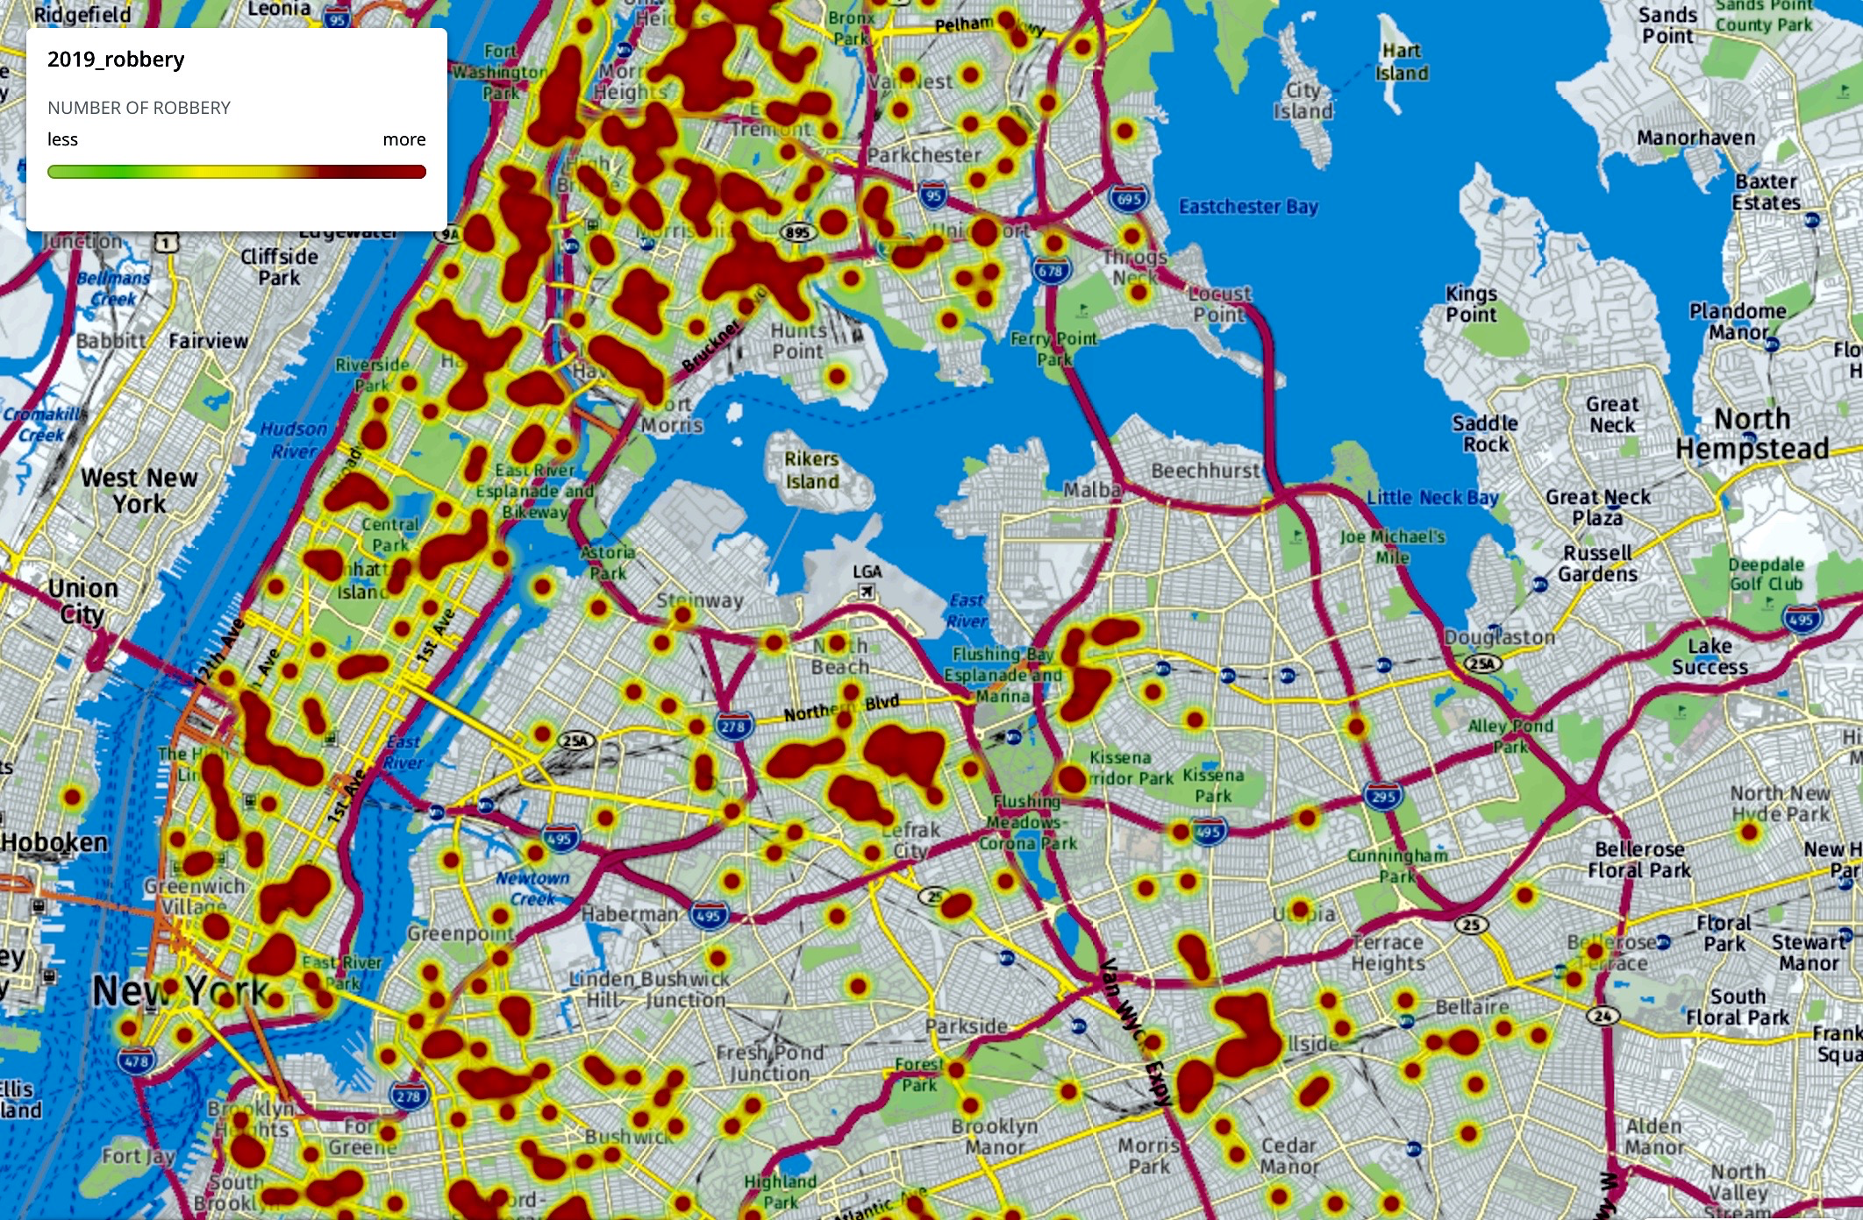
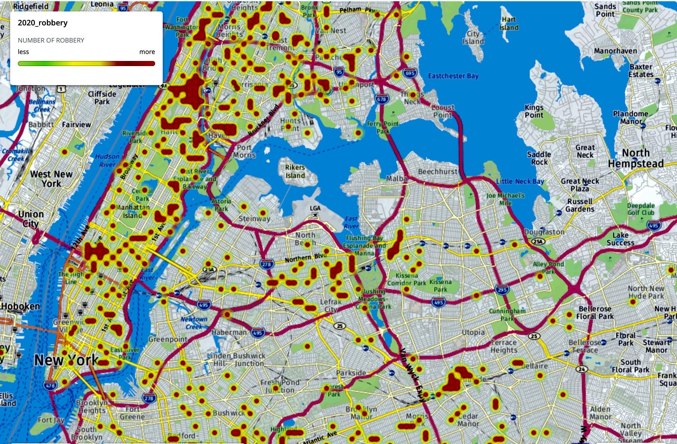
Crime Heatmaps
We also generated heat maps to visualize the crime concentrations in year 2020 compared with previous years:
2018
2019
2020
Burglary
Robbery
# of burglary cases increased and # of robbery cases decreased during 2020 pandemic.
Crime concentration areas have shifted(Mid Manhattan area, etc.) compared with previous years.

Slide 6
Discussion
Conclusion: Shelter-in-place order makes burglaries easier and criminals are shifting strategies during the pandemic. Empty properties near areas like Midtown Manhattan can be vulnerable to burglaries.
Limitations: Our analysis only focused on burglary and robbery cases within NYC. Also, if we had data regarding the type of businesses in each location, we could show which businesses were more vulnerable to crime during the pandemic.
Future work: We hope to enrich our analysis with more data sources such as types of businesses being targeted, crime time of a day, etc. Also, we hope to spread this analysis to alert people and businesses of crimes during this pandemic.
(Slide Template was borrowed from PoweredTemplate.com)

